Slide 1


CS442 Term Project MobilePT:~~~~
Team 1 Elevator Pitch
InYong Koo, ChangHeon Kim

Slide 2

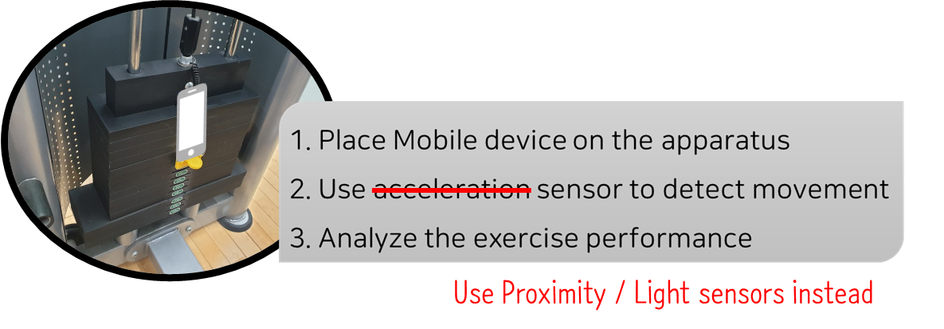

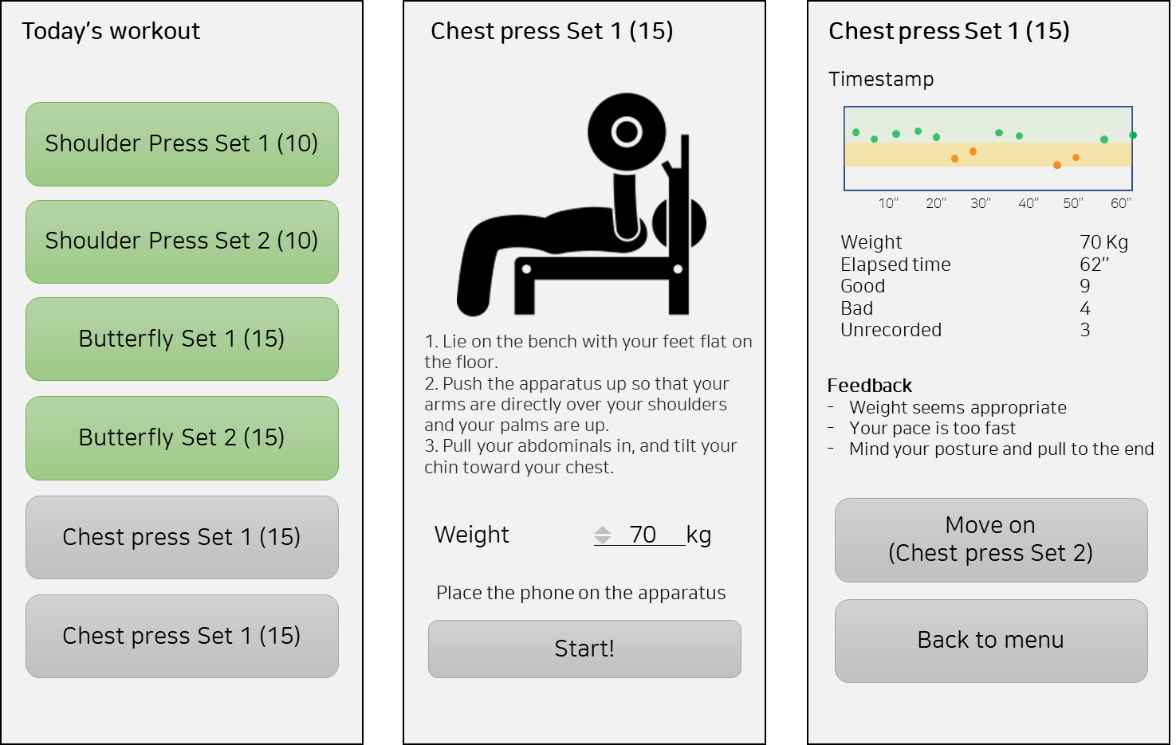
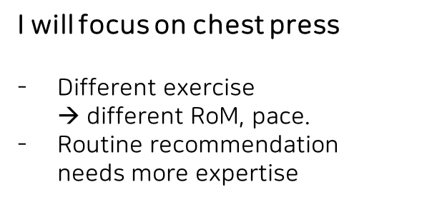
Notes:
Keywords
Classifier, Perceptron
Loss function, Backpropagation, Hyperparameter
Adam optimizer,

Slide 3
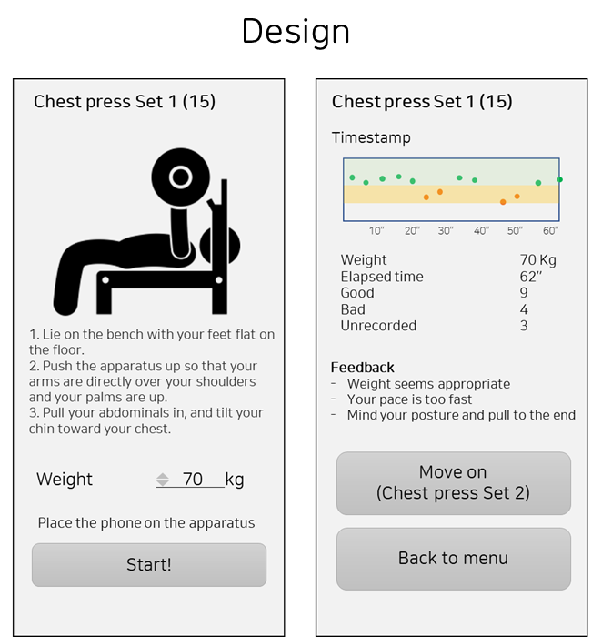
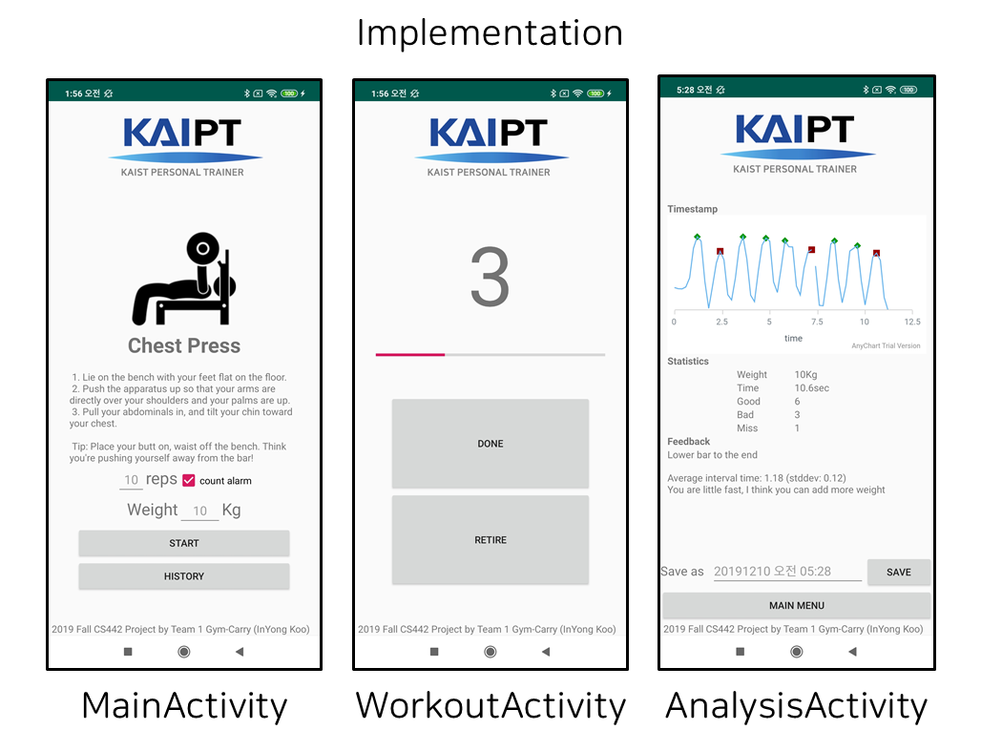
User Interface
Notes:
Keywords
Classifier, Perceptron
Loss function, Backpropagation, Hyperparameter
Adam optimizer,

Slide 4
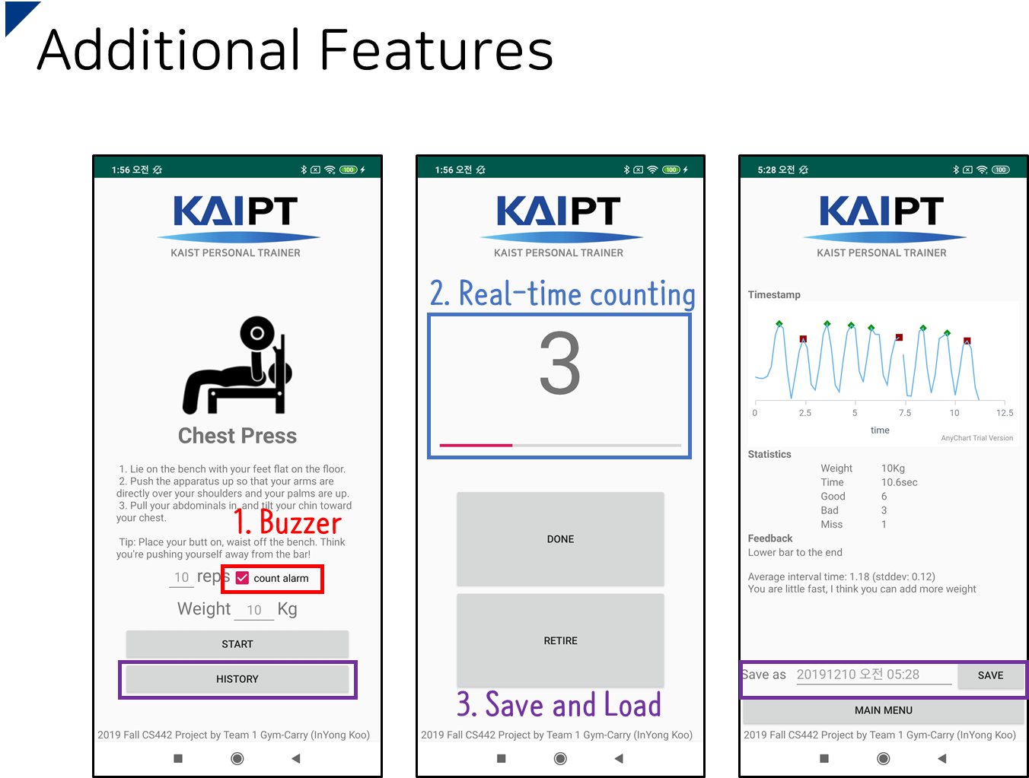
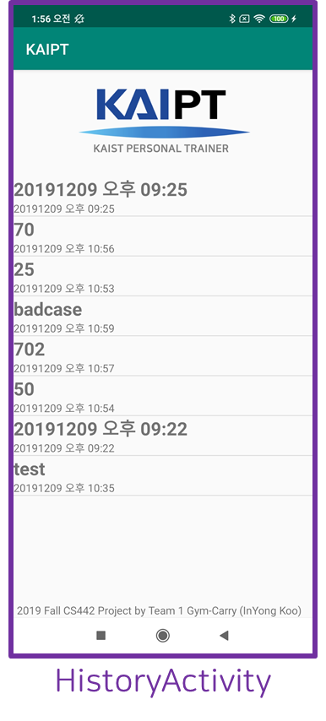
Notes:
Keywords
Classifier, Perceptron
Loss function, Backpropagation, Hyperparameter
Adam optimizer,

Slide 5

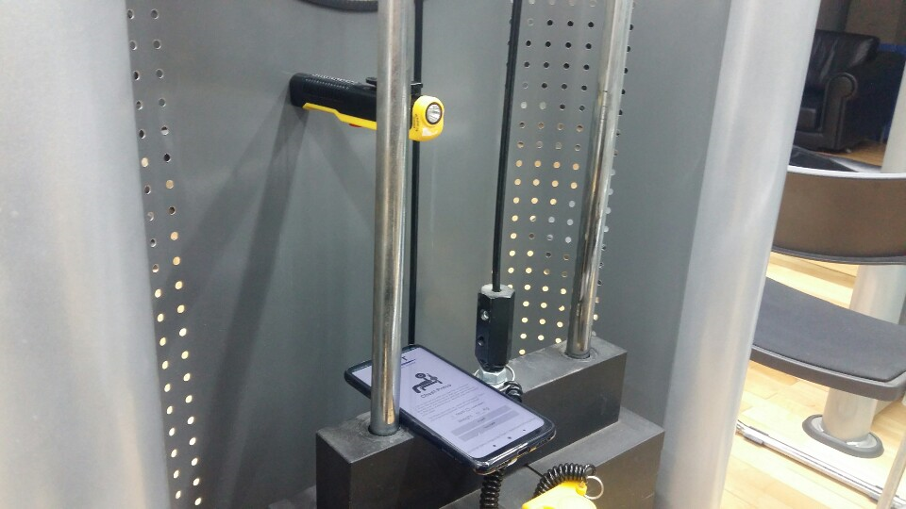
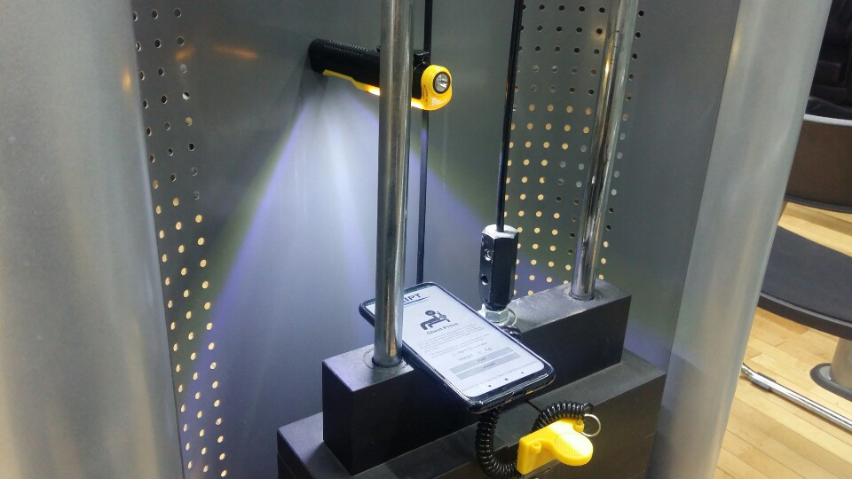
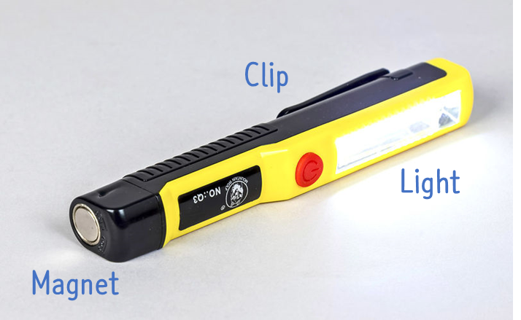


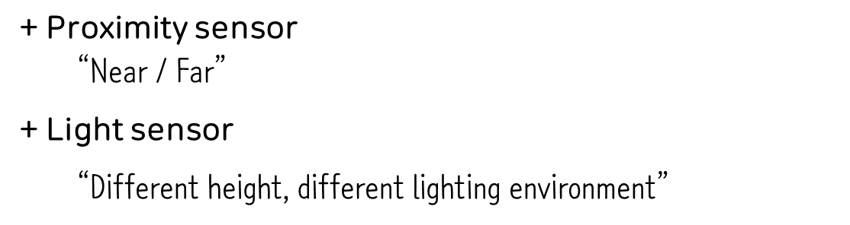
Notes:
Keywords
Classifier, Perceptron
Loss function, Backpropagation, Hyperparameter
Adam optimizer,

Slide 6

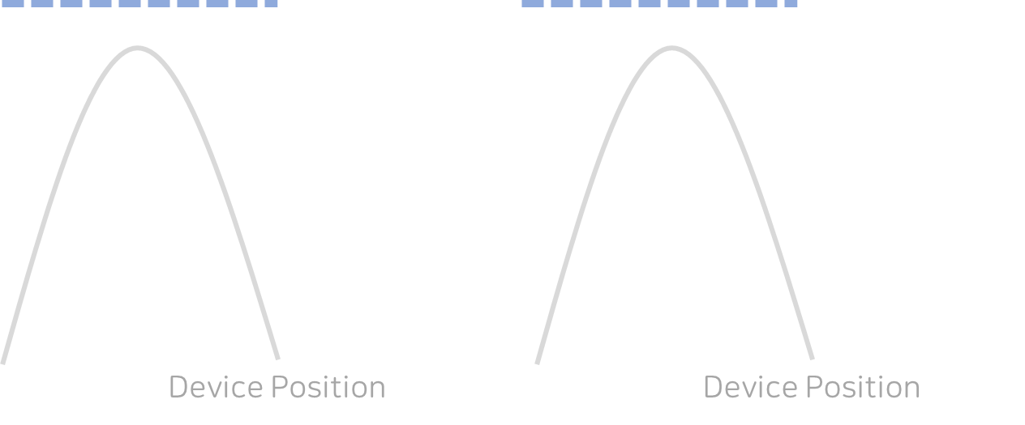
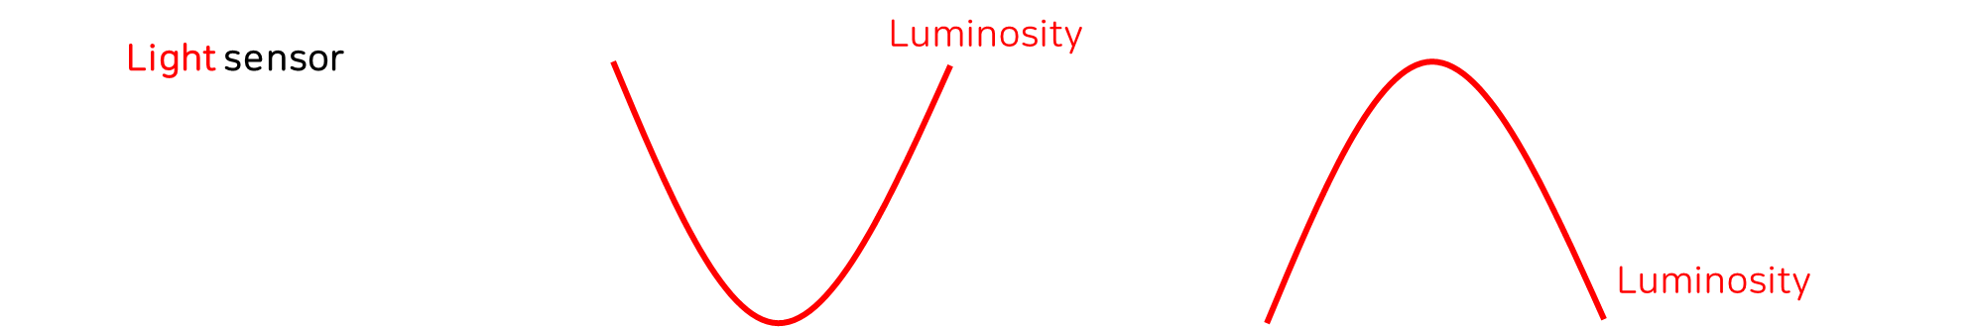
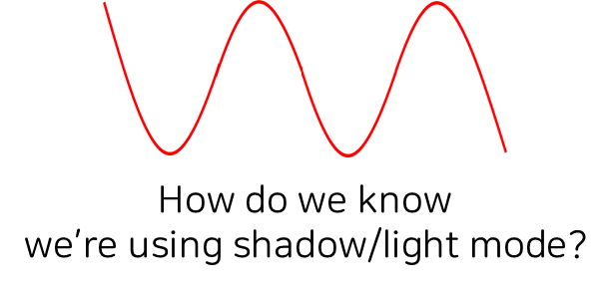
Notes:
Keywords
Classifier, Perceptron
Loss function, Backpropagation, Hyperparameter
Adam optimizer,

Slide 7




Near
Proximity sensor
Near
Notes:
Keywords
Classifier, Perceptron
Loss function, Backpropagation, Hyperparameter
Adam optimizer,

Slide 8

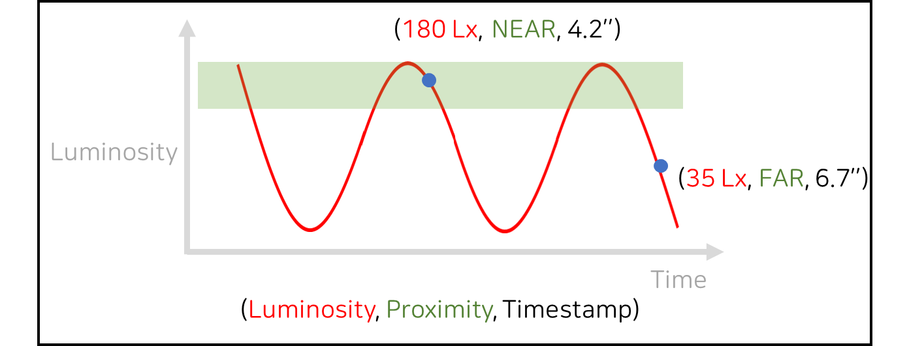
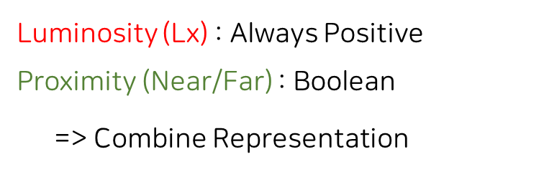
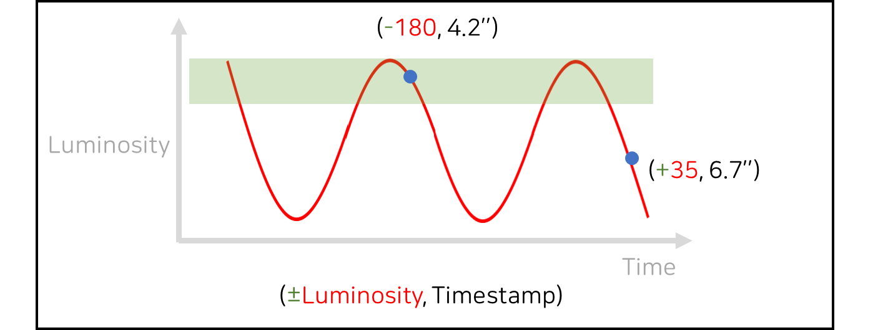
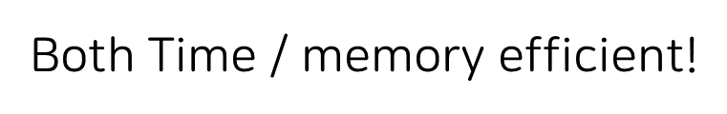
Notes:
Keywords
Classifier, Perceptron
Loss function, Backpropagation, Hyperparameter
Adam optimizer,

Slide 9

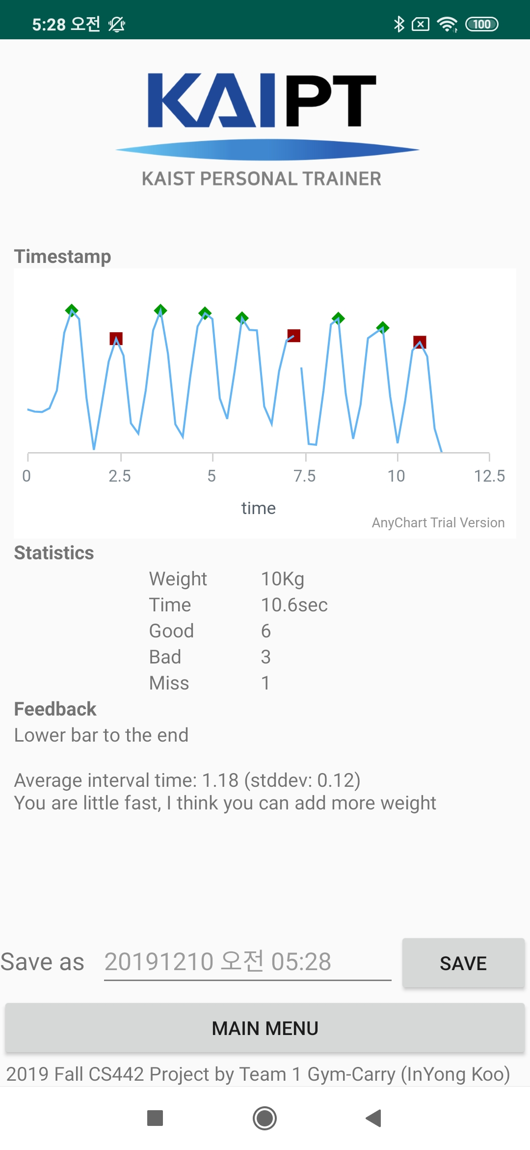

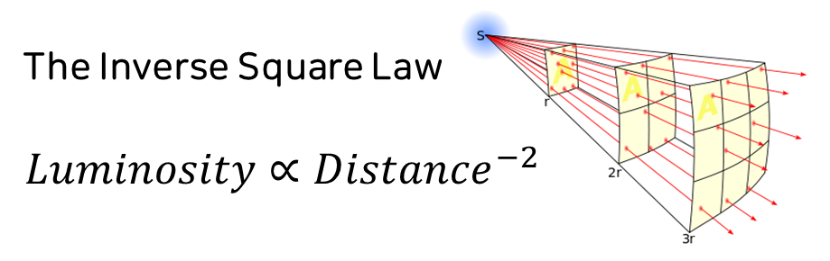
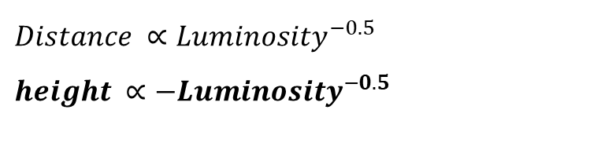
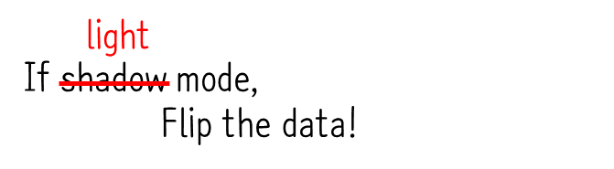
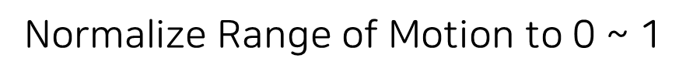
Notes:
Keywords
Classifier, Perceptron
Loss function, Backpropagation, Hyperparameter
Adam optimizer,

Slide 10
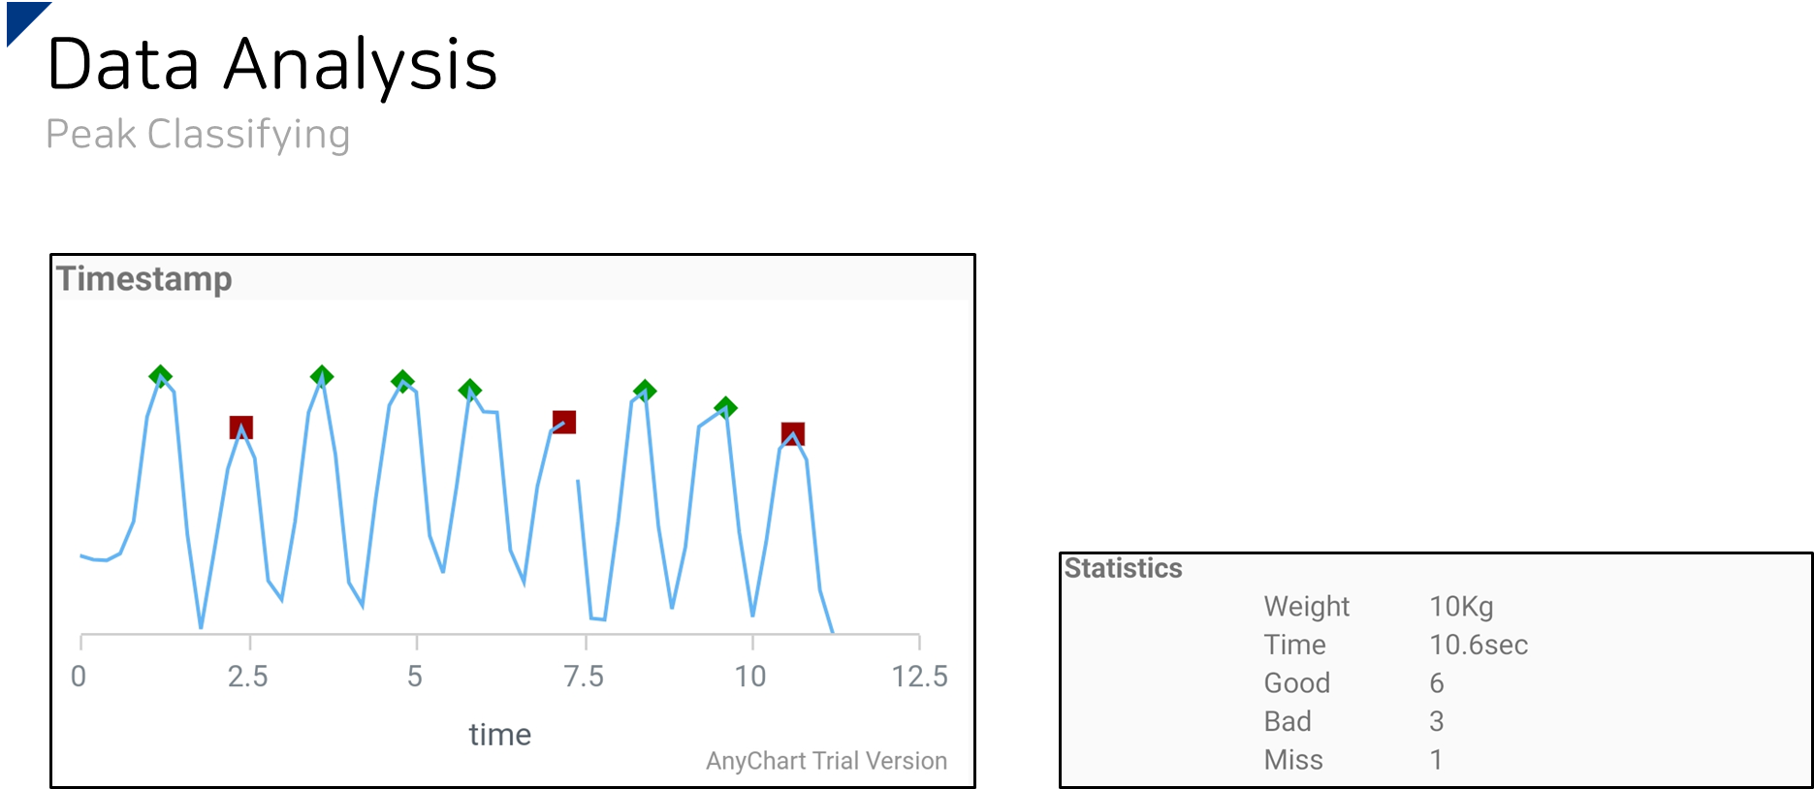
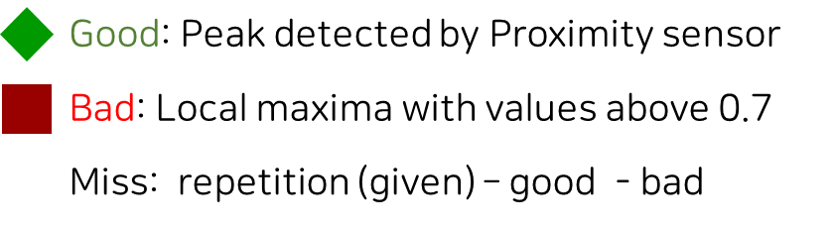
Notes:
Keywords
Classifier, Perceptron
Loss function, Backpropagation, Hyperparameter
Adam optimizer,

Slide 11

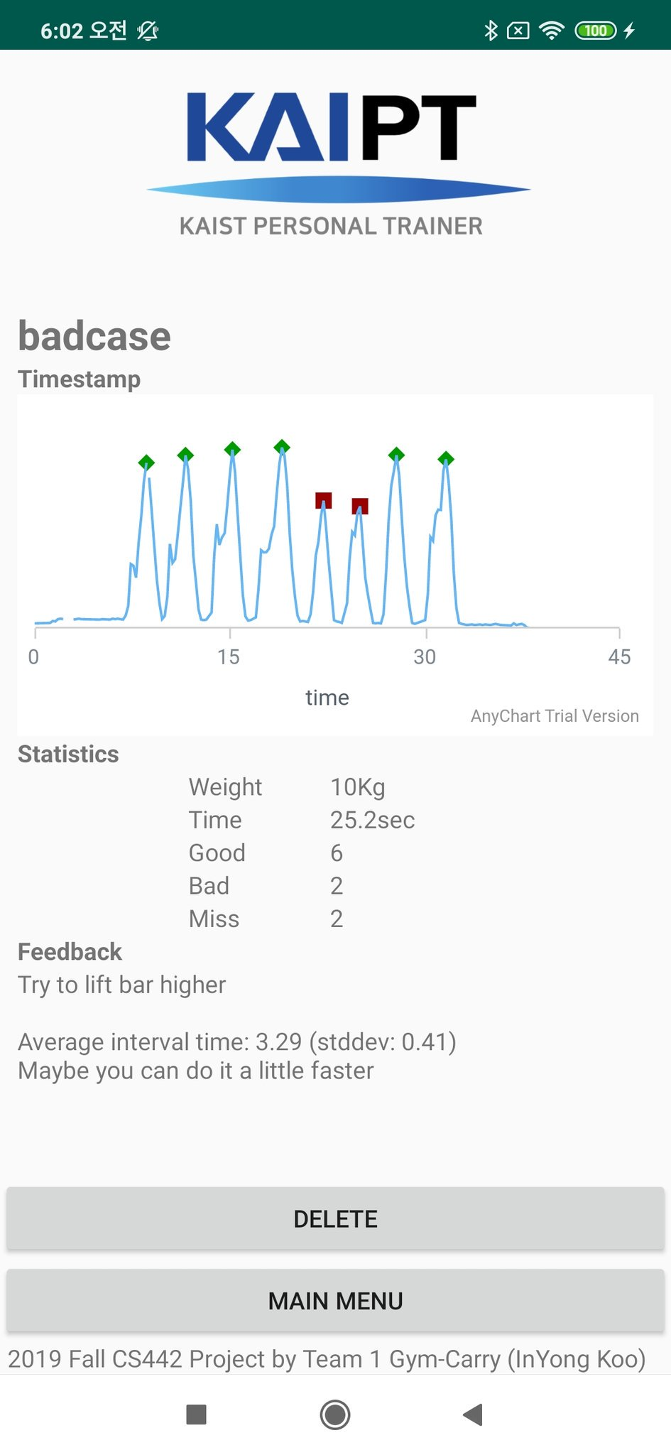
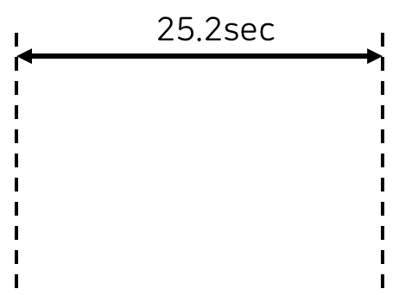
Notes:
Keywords
Classifier, Perceptron
Loss function, Backpropagation, Hyperparameter
Adam optimizer,

Slide 12

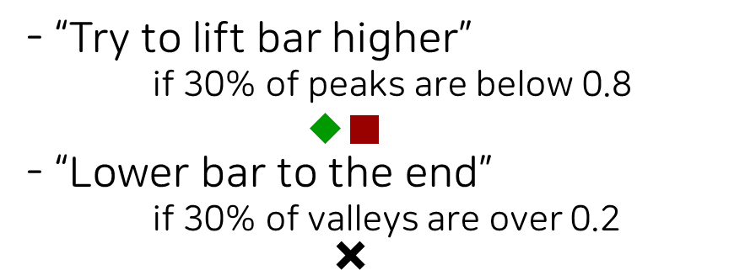
Notes:
Keywords
Classifier, Perceptron
Loss function, Backpropagation, Hyperparameter
Adam optimizer,

Slide 13

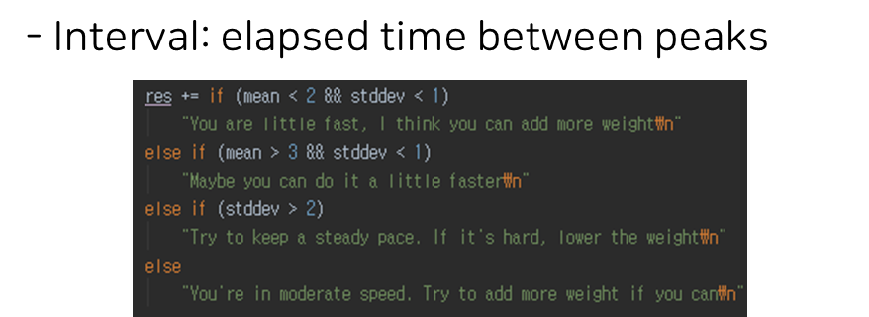
Notes:
Keywords
Classifier, Perceptron
Loss function, Backpropagation, Hyperparameter
Adam optimizer,

Slide 14

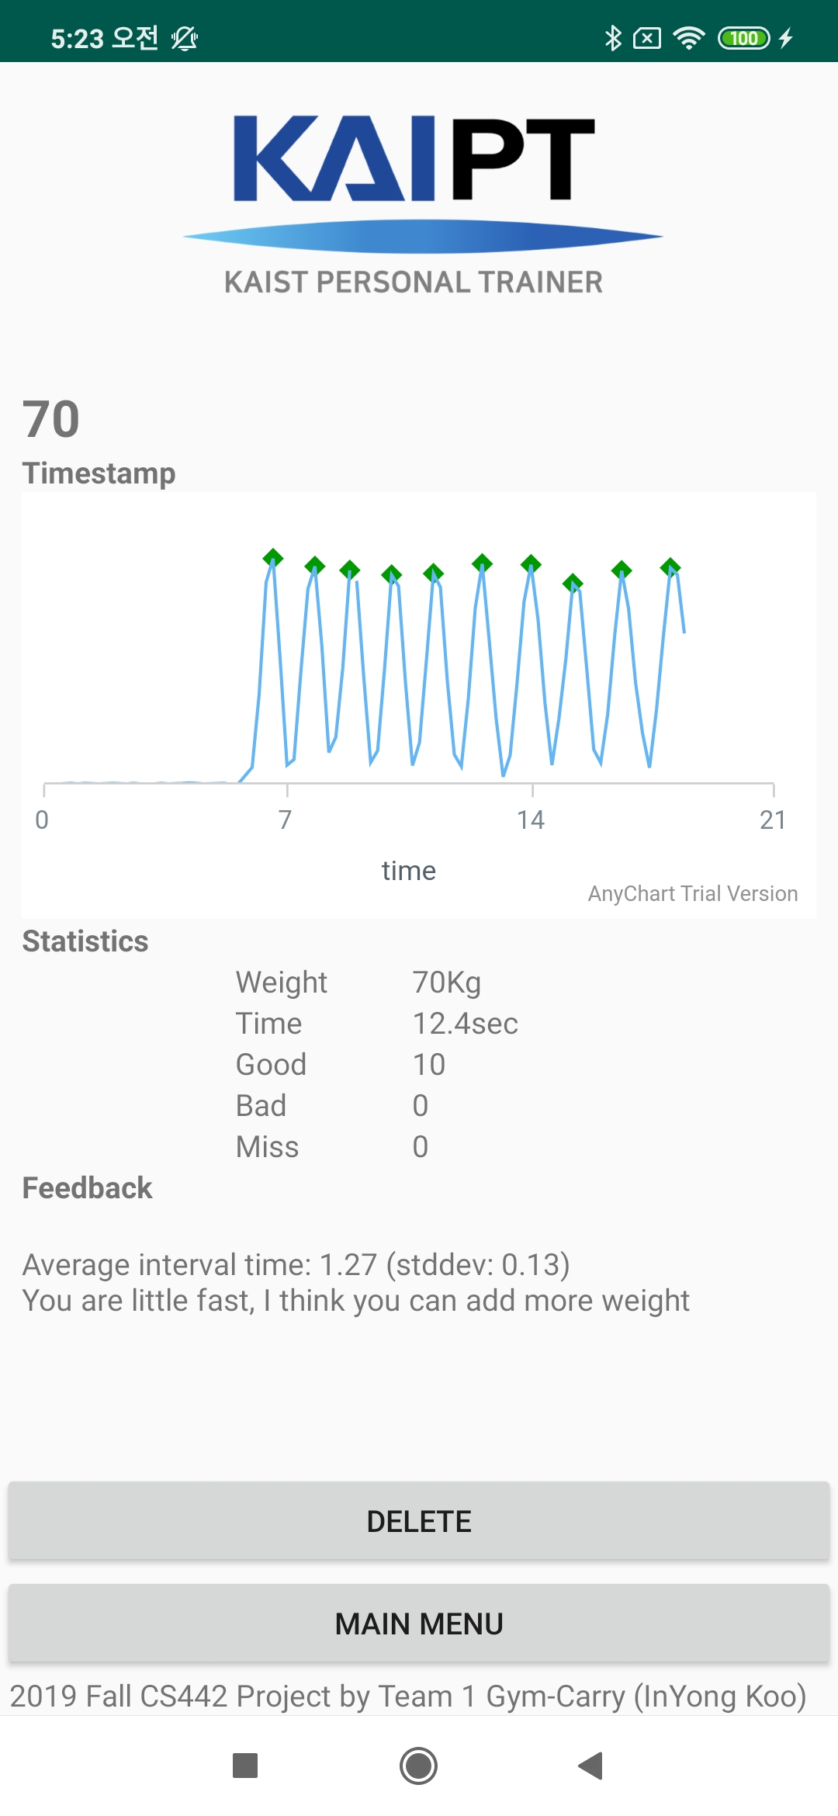
Notes:
Keywords
Classifier, Perceptron
Loss function, Backpropagation, Hyperparameter
Adam optimizer,

Slide 15

Notes:
Keywords
Classifier, Perceptron
Loss function, Backpropagation, Hyperparameter
Adam optimizer,

Slide 16

Notes:
Keywords
Classifier, Perceptron
Loss function, Backpropagation, Hyperparameter
Adam optimizer,

Slide 17


